Slide 1
DoIT
ITC209 Assessment Item 5 App Presentation
Shirish Maharjan
11598385

Slide 2
Introduction
My name is Shirish Maharjan and I’m from Kathmandu, Nepal.
I am pursuing a Bachelor’s in Information Technology (Specializing in Software Development).
I love Science and Technology therefore to be involved in the field I have pursued this degree.
For short term I am looking for a Web Developer role. However, I would love to be involved in other fields in Software Development.
In long term I want to go back to my country and use technology to help in their day to day lives.
I have experience in Java, Java EE, JAX RS and other web APIs.

Slide 3
App Overview
A checklist helps us to stay focused and productive.
DoIT is a simple to do list application allowing users to add, edit and delete tasks and set a due date for the task.
The due date is a reminder for the user to stay focused on tasks.
Anyone looking to stay productive can use this app.
In this current day and age where everyone is busy, a to do list app comes in handy to stay productive.

Slide 4
Intended Functionality
Add a Task to the database.
Add a Due Date and Time for a task and set a notification an hour before the due time.
Edit a Task and update the database.
Delete a Task/ Mark as done and delete the task from the database after 7 seconds.

Slide 5
Continued….
Users can add a task to the application which they need to do.
Added task is saved in the database for users to view later.
Edit a task when required allowing users to make changes to the tasks entered.
What’ the point of a checklist if one cannot mark it as done.
The satisfaction of completing a task is realized when the checkbox next to the task is checked and the task is deleted from the database.

Slide 6
Reminder Notification
Do it also allows user to set a due date and time.
This allows the application to send a reminder.
A reminder is sent an hour before the task is due.
Reminders remind users to stay focused and productive.

Slide 7
Platform Used
Android Platform chosen for the development of the app.
Android is the most popular platform used today.
Google Play Store has the most number of applications.

Slide 8
Tools Used
Android Studio used as IDE.
Android SDK API 18 (JellyBean 4.3) was used to develop the application.
Wdullaer Library was used for adding Date and Time Picker.

Slide 9
Device Requirements
OS Version: Android 4.3(Google APIs) API 18
AVD used while testing:
Nexus 5 with API 18, Android 4.3(Google APIs)

Slide 10
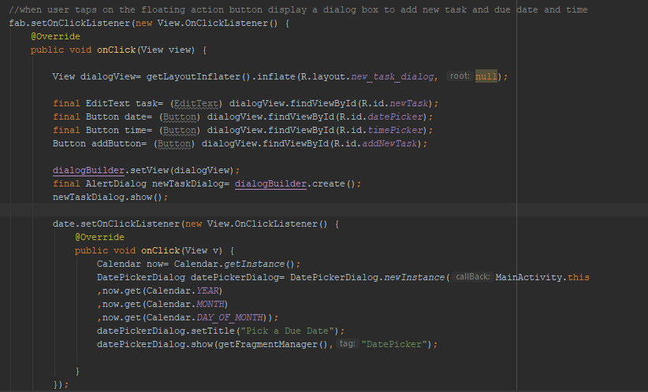
Techniques and Challenges
Interesting technique 1
Using different layout and inflating them inside a particular section.
Using a different layout for a dialog box as shown in the screenshot.

Slide 11
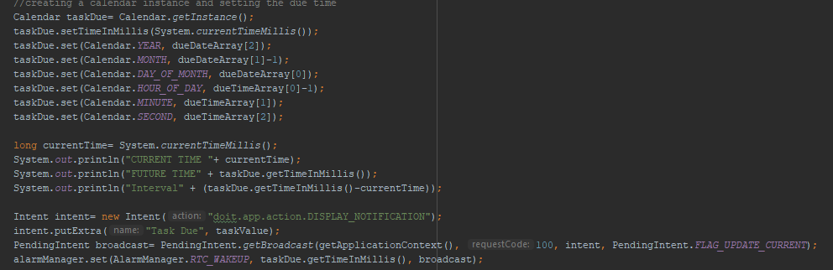
Techniques and Challenges continued…
Interesting technique 2
Using Calendar to set a certain time in a day and passing it to different methods.
Due Date and Time is set through Calendar to create a notification.

Slide 12
Techniques and Challenges continued..
Interesting technique 3
Toast Messages
Toast Messages are a brilliant and easy method to give feedback to the user.

Slide 13
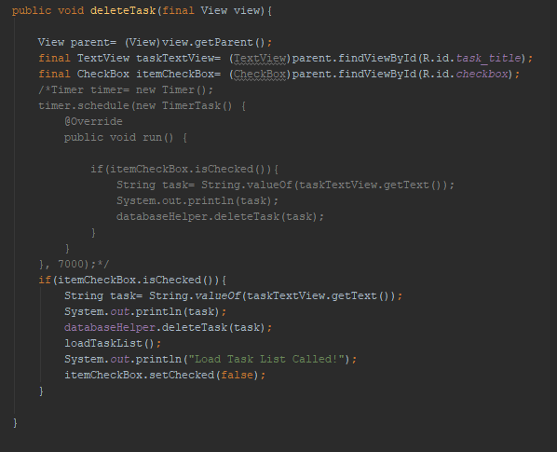
What couldn’t be done?
The task when checked to be deleted after 7 seconds.
Was done however created some bugs which didn’t update the ListView being displayed.
Insted now task is deleted immediately after checkbox is checked.
Commented out code in the screenshot was used for the 7 second delay.
Slight changes in UI were made for better usability. For instance: Introduction of dialog box while adding or editing a task.

Slide 14
Improvements for the Future
Social aspect can be added to the application.
Can be updated to a to do list application allowing multiple users to use the same list.
Allow application to be used for business projects, university assignments and so on.
More options and menus can be added when social aspect is added to the application.
More informative notification can be added.
The deletion of task after 7 seconds can be done too.

Slide 15
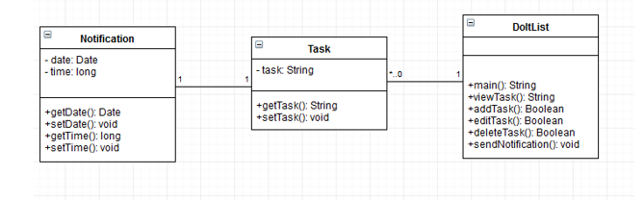
App Architecture
Class Diagram

Slide 16
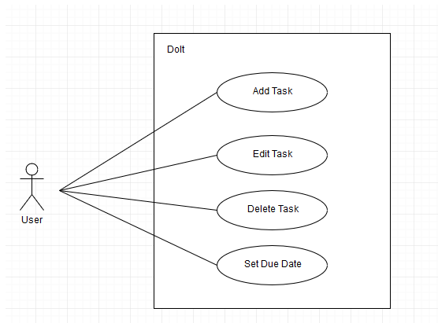
App Architecture continued..
Use Case Diagram

Slide 17
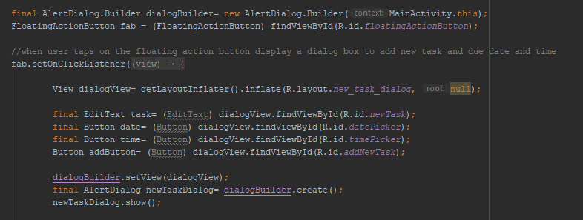
Add Task
Floating action button used to add a task
When floating action button is pressed new_task_dialog.xml is inflated which is the layout for the add task dialog box.
Next slide shows event handler for the add button in the dialog box.

Slide 18
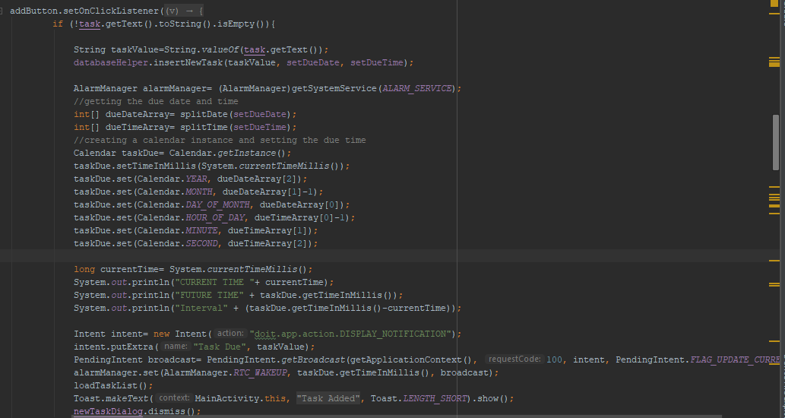
Add Task continued..
When add task button is pressed, if condition checks if a task is entered.
If task is entered, it is added to the database using an instance of the DatabaseHelper class
The due date and time set by user is used to create a notification using alarm manager.
Calendar instance created to which current time and picked time is added.
Time from calendar instance in milliseconds and the pending intent is passed to the alarm manager.

Slide 19
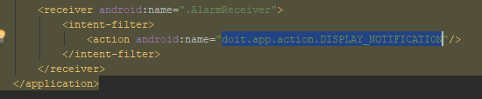
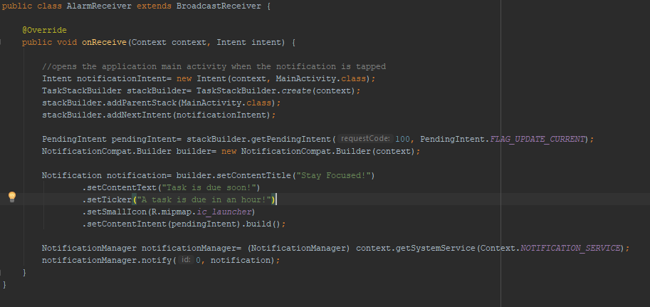
Changes in AndroidManifest.xml file
AlarmReceiver added in manifest file so that when “doit.app.action.DISPLAY_NOTIFICATION” is called, AlarmReceiver’s onReceive method is called.
New intent instance is created to launch main activity when notification is tapped.
Contents of notification is set.

Slide 20
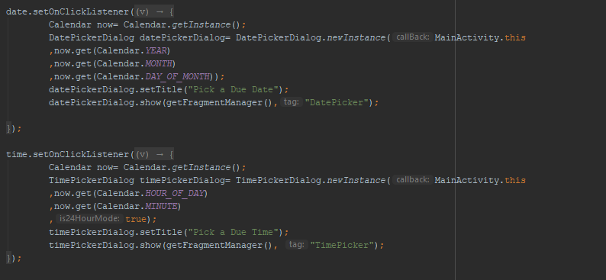
Set Due Date (Creating a date and time picker dialog)
This code handles the set due date and due time button in the add task dialog box.
When respective buttons are clicked, respective dialog box are displayed using the Wdullaer Library.
When date or time is picked, it is set in a global variable.
These variables are accessed when a notification needs to be set at a specific time.

Slide 21
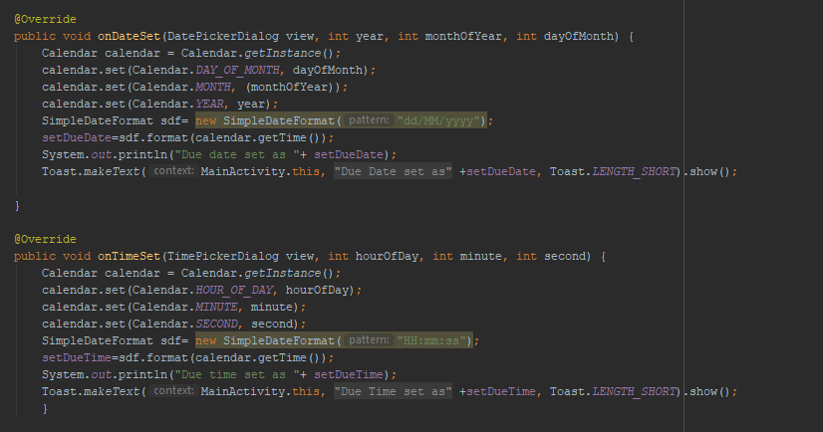
Set Due Date continued.. (What happens when a date and time is set)
Picked date set to Global Variable setDueDate.
Picked date time to Global Variable setDueTime.

Slide 22
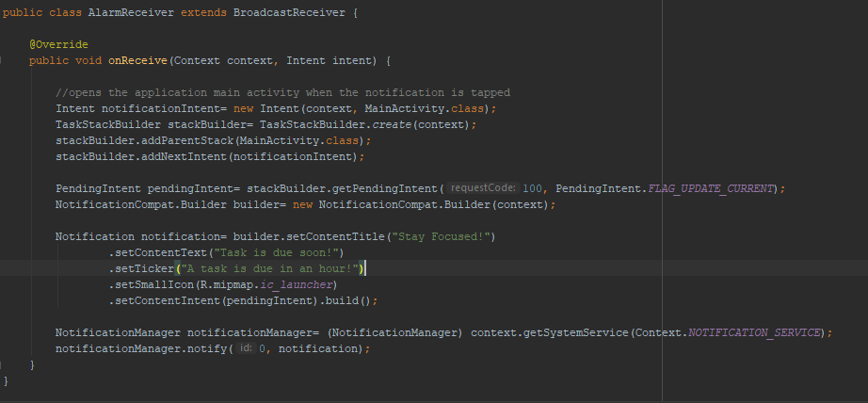
Set Due Date continued.. (Setting an alarm as soon as a task is added using Alarm Receiver)

Slide 23
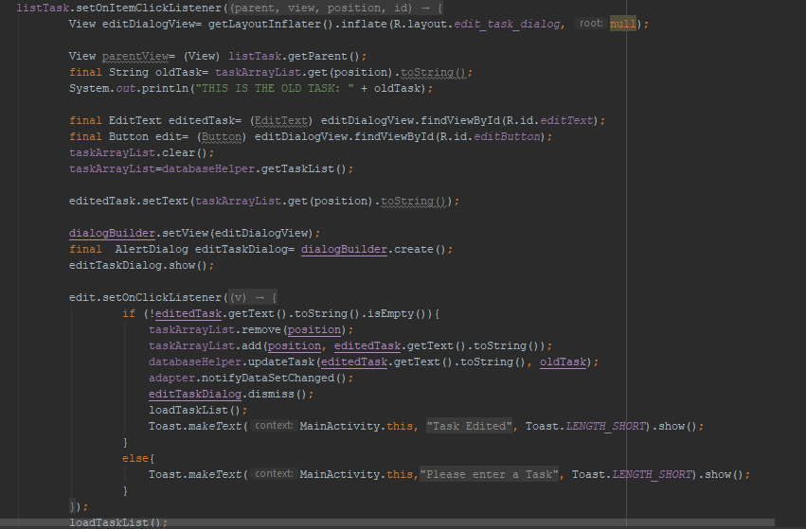
Edit Task
Edit allowed when existing task is tapped.
Code shows how dialog box for edit is displayed with edit button.
When Edit button is pressed, task is edited, database is updated and toast message is displayed.

Slide 24
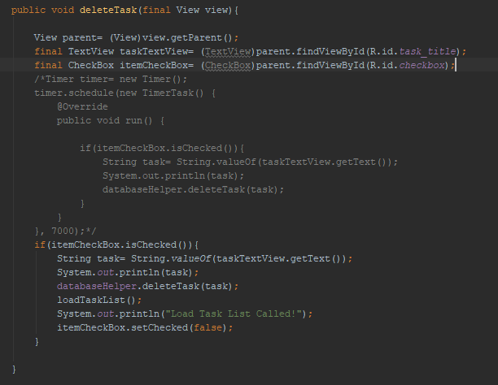
Mark as done/ Delete task
This method is called when check box is checked.
Code checks if check box is checked after which task is deleted.
Commented code was done to delete the task after 7 seconds.
This deleted the task in 7 seconds however bugs were there. Therefore it was ignored.

Slide 25
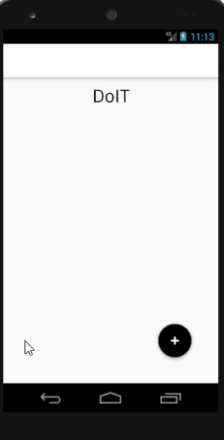
Demonstration
Firstly adding a task to the to do list and setting a due date and time.
When due time approaches a notification is sent notifying the user that a task is due. (1 hour before task is due)
Task is deleted by checking the check box.
Task is edited by simply tapping on the text.
Even when application is reopened, entered tasks exists because they are stored in a internal database.

